Slide 1
Farm Fresh Online store

Slide 2
Problem Statement
This system is used for online management of fruit product. Using this system admin not only maintain records of products but also maintaining customer records, payment records , customers order record and generate report daily and monthly basis. Customer order details and bill details automatically send by system through e-mail
Admin:
can add/modify the fruit details
admin can view customers
Admin can manage payment
Admin generates bill
Send email to customer
Admin can view order

Slide 3
Problem Statement
Customer:
Customer need to signup into system
Customer login to system
Customer can view products
Customer can search fruits by fruit name and fruit category
Customer makes order
Customer can check orders
Customer can add fruits to cart

Slide 4
Road Map
Application will be developed in following Sprints –
Core Java +JPA with Hibernate
Spring Boot + Rest Controller + JPA with Hibernate
Angular for UI design (Front End) + Integration with previous Sprint

Slide 5
Plan
Design
Generate the skeleton as per class design provided
TDD approach
Identify test cases for each module like for example you need to test login module for customer ,in this approach, you can use Mockito framework to mock the Login Service and other different services as per module and test the login functionality , admin functionality , customer functionality , order functionality , payment functionality
Write failed test cases
3. Convert test cases into GREEN.
Implement the case study in incremental manner

Slide 6
Modules
Admin Module
Customer Module
Item Module
Payment Module
Order Module
Cart Module

Slide 7
Modules List:
Admin :
Admin can add fruits into system
with all necessary attributes
Admin can modify fruits like price, name , category e.t.c
admin can delete fruit items
admin can view all items
admin can view customer details
admin can manage order of customer
admin will send invoice to customer
admin should manage the payment details

Slide 8
Modules List:
Customer :
customer need to signup to system
In this module customer will login into system
Once customer will login customer can , In this module customer can view fruits, discounts e.t.c
customer can search fruits based on fruit name or category
customer can view fruits in order(low price to high price or high price to low price)
can check availability status of a particular fruit item
customer can buy fruits from farm
in this module customer can check their order details and status
Customer can log out from system.

Slide 9
Modules List:
Item :
Item can be added by admin
In this module item can be modified by admin
In this module item can be deleted by admin
Items can be searched by admin and customer
Items can be sorted by admin and customer
Items count and item’s price count can be calculated by only admin

Slide 10
Modules List:
Item category :
Item category can be added/modified/deleted by admin.
Item category can be searched and sorted by admin and customer

Slide 11
Modules List:
Order :
In this module, order can be added by customer
Order can be modified with condition by customer
Order can be cancelled by customer and order can be deleted by admin
Order can be searched and sorted by admin and customer
Total order and amount of order can be calculated by admin

Slide 12
Modules List:
Payment :
Payment details like customer name, phone number, email id and bank details and mode of payment must be accepted from customer
List of successful payment check by admin and then send bill to customer by mail
List of unsuccessful payment check by admin and send error message to customer by mail

Slide 13
Modules List:
Cart :
In this module fruit item will be selected and added to the cart by customer.
Cart can be updated and deleted by customer.
Cart can be also be view by admin.

Slide 14
Modules List:
Login :
Admin and customer both users should login with user name and password.
Both can have provision to recover user name and password
Both can change user name and password

Slide 15
Modules List:
Logout :
Admin and customer both users both can successfully logged out from system

Slide 16
Manage Global Exception:
You must have to manage exceptions in different situation of our application like
A. if you will try signup with same customer details then you should handle exception like “User Already Exists”
B. If Customer try to login with invalid credential then customer should get exception message as “InvalidLoginException” .
C. Incase if admin try to insert same item with duplicate identifier then you should handle exception like
“Duplicate Product Id Exception
:

Slide 17
Validation and Constraints:
All fields for each component should be well validated like in login module password and confirm password both should match,
password must be of min 8 max 12 chars with letters and numbers
check field like username, email, mobile number, date of birth with valid regex.
:

Slide 18
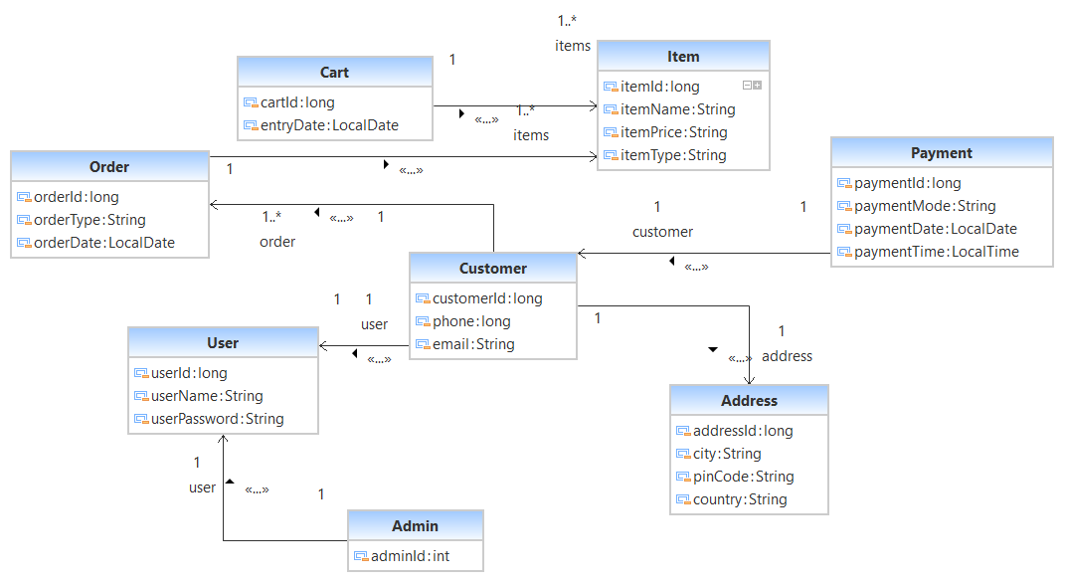

Slide 19
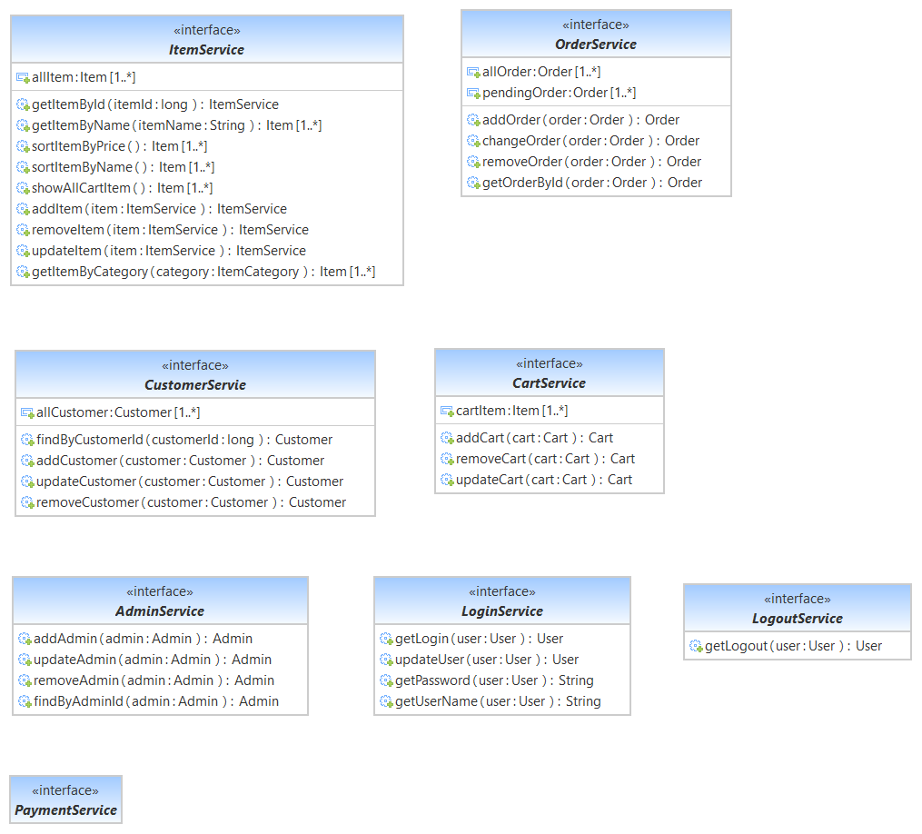

Slide 20




Questions

